Slide 1


VISVESVARAYA TECHNOLOGICAL UNIVERSITY
Jnana Sangama, Belagavi Karnataka-590018
MARATHA MANDAL’S ENGINEERING COLLEGE, BELAGAVI
DEPARTMENT OF ELECTRONICS AND COMMUNICATION ENGINEERING
PROJECT ON
“Smart Agriculture Based on IOT and AI”
Presentation by
RAGHAVENDRA B PATIL 2MM22EC026
MANIKANTH PATIL 2MM22EC015
KIRAN KALYANI 2MM22EC012
SHRAVANKUMAR PATIL 2MM22EC036
Under the guidance of
Prof. Sumitra Kubyal

Slide 2
Smart Agriculture Based on IOT and AI

Slide 3
ABSTRACT
The Automatic Irrigation System is designed to optimize water usage in agriculture by intelligently monitoring soil moisture, water tank levels, and environmental conditions. The system utilizes a soil moisture sensor to detect the soil’s water content and an ultrasonic sensor to measure the water level in the storage tank. A DHT11 sensor continuously monitors temperature and humidity to further enhance irrigation decisions. An Arduino Uno serves as the central controller, processing sensor data and managing system operations, including activating a DC pump when both soil moisture and water levels fall below predefined thresholds. The NodeMCU module uploads real-time sensor data to the Adafruit IoT dashboard, enabling remote monitoring, while a GSM module sends alert messages during abnormal conditions. Additionally, an LCD displays the current status of all sensors locally, and a buzzer provides audible warnings for critical events. The system is powered sustainably using a 9V solar panel and battery setup, ensuring continuous and eco-friendly operation. This integrated approach enhances irrigation efficiency, conserves water, and supports smart farming practices.

Slide 4
INTRODUCTION
The Automatic Irrigation System aims to optimize water usage in agriculture by using sensors to monitor soil moisture, water levels, temperature, and humidity. Controlled by an Arduino Uno, the system activates a DC pump only when necessary, conserving water and preventing damage. Real-time data is uploaded to an Adafruit IoT dashboard via NodeMCU, while a GSM module sends alerts during abnormal conditions. The system features an LCD display for local monitoring and is powered sustainably by a 9V solar panel with a battery backup. This smart, automated approach promotes efficient irrigation and supports sustainable farming practices.

Slide 5
Literature survey
AUTOMATIC PLANT IRRIGATION SYSTEM
The "Automatic Plant Irrigation System" (APIS) automates irrigation by monitoring soil moisture levels to control a water pump. It reduces human intervention by detecting soil dampness using a soil moisture sensor and activating the pump when irrigation is needed. The system operates in three stages: sensing moisture, determining soil condition, and controlling the motor. Implemented with an LM358 operational amplifier, APIS currently manages irrigation for a small area, aiming to improve farming efficiency and minimize losses from drought or improper watering.

Slide 6
Literature survey
Automatic irrigation system for plants
This project aimed to develop an automatic irrigation system for indoor plants, focusing on energy efficiency, system stability, and wireless control. A microcontroller, water pump, and moisture sensor were used to monitor and irrigate a plant over four weeks. The system successfully maintained the plant’s health, and its energy needs were met using solar power, making it a sustainable alternative to battery usage.

Slide 7
Existing model
Current automatic irrigation systems typically use soil moisture sensors and water level sensors to control pumps and prevent damage. Many rely on Arduino for local control, while some include temperature and humidity monitoring. However, few systems integrate real-time IoT monitoring, GSM alerts, and solar-powered operation together. The proposed system aims to fill this gap by combining all these features for a smarter, more efficient, and sustainable irrigation solution.

Slide 8
Proposed model
The proposed automatic irrigation system integrates multiple sensors and technologies to optimize water usage and enhance agricultural efficiency. Soil moisture sensors monitor soil hydration, while ultrasonic sensors track water reservoir levels. A NodeMCU microcontroller uploads sensor data to the Adafruit IoT platform for real-time remote monitoring. A GSM module sends alert messages during abnormal conditions, and a buzzer provides immediate local warnings. The system uses an LCD to display all sensor statuses, ensuring easy onsite monitoring. Powered by a 9V solar panel and battery, the system is energy-efficient and sustainable. When soil moisture or water levels fall below set thresholds, a DC pump is automatically activated to irrigate the crops, ensuring timely water supply and preventing wastage. This model offers a comprehensive, smart, and eco-friendly approach to irrigation management.

Slide 9
Block diagram
Arduino uno
Slar panel (9v)
Battery
Lcd
Buzzer
Soil moisture sensor
Gsm
Relay
Dc pump
Ultrasonic sensor
Nodemcu
Dht11 sensor

Slide 10
components
Hardware components
Software requirement
Arduino uno
Dht11 sensor
Soil moisture sensor
Ultrasonic sensor
Lcd
Relay
Dc pump
Buzzer
Gsm
Nodemcu
Solar panel(9v)
Battery(12v)
Arduino ide
Embedded c
python

Slide 11
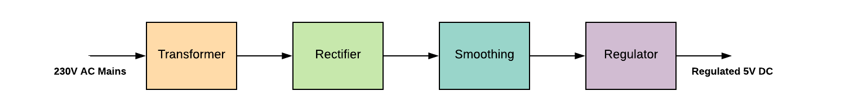
Power Supply
A step-down transformer converts the 230V AC into12v.
The bridge rectifier is used to change AC to DC
A capacitor is used to filter the AC ripples and gives to the voltage regulator.
Finally voltage regulator regulates the voltage to 5V and finally, a blocking diode is used for taking the pulsating waveform.

Slide 12

Arduino uno
The Arduino Uno is a versatile and widely-used microcontroller board designed for electronics prototyping and educational purposes. At its core, it features the ATmega328P microcontroller and operates at a 5V voltage with a 16 MHz clock speed. The board offers 14 digital I/O pins, 6 of which can be used as PWM outputs, and 6 analog input pins for various sensor integrations. With 32 KB of flash memory, 2 KB of SRAM, and 1 KB of EEPROM, the Uno provides ample resources for developing and running complex programs. It is programmed using the free, open-source Arduino IDE, which supports C and C++ programming languages. Common applications for the Arduino Uno include building prototypes, teaching electronics, and creating DIY projects such as home automation systems, weather stations, and robots.

Slide 13
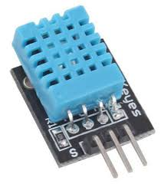
Dht11 sensor
The DHT11 sensor is a widely used digital sensor that measures temperature and humidity. It provides reliable and accurate readings by using a thermistor for temperature and a capacitive humidity sensor. The DHT11 communicates with microcontrollers through a single-wire digital interface, making it easy to integrate into various projects. It is often used in applications such as weather stations, HVAC systems, and environmental monitoring. With a measurement range of 0-50°C for temperature and 20-80% for humidity, the DHT11 offers a practical solution for basic climate monitoring needs. Its affordability and simplicity make it a popular choice for both hobbyists and professionals.

Slide 14
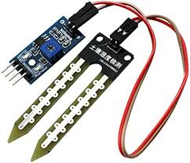
Soil moisture sensor
A soil moisture sensor is a device that measures the water content in soil. It works by detecting the electrical resistance, dielectric constant, or capacitance of the soil, which changes with moisture levels. These sensors are widely used in agriculture, gardening, and environmental monitoring to optimize irrigation, prevent overwatering, and conserve water.Soil moisture sensors are typically used in automated irrigation systems, where they help determine when to water plants based on real-time soil moisture data. By providing accurate readings of soil moisture levels, these sensors contribute to efficient water use, healthier plants, and better crop yields. They are essential tools in modern precision agriculture, enabling farmers to make data-driven decisions about irrigation..

Slide 15
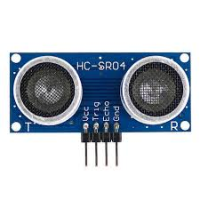
Ultrasonic sensor
An ultrasonic sensor measures distance by emitting high-frequency sound waves and detecting their reflection from objects. It calculates distance based on the time taken for the sound waves to return. Widely used in robotics, automotive systems, industrial automation, and home security, ultrasonic sensors are valued for their accuracy, reliability, and ability to detect objects regardless of color or lighting conditions. They are essential for obstacle avoidance, level measurement, and presence detection, making them a versatile choice for various applications.

Slide 16
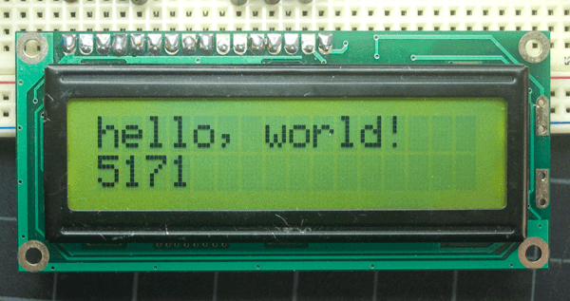
Lcd
A liquid-crystal display is a flat-panel display or other electronically modulated optical device that uses the light-modulating properties of liquid crystals combined with polarizers. Liquid crystals do not emit light directly but instead use a backlight or reflector to produce images in color or monochrome
LCDs are used in a wide range of applications, including LCD televisions, computer monitors, instrument panels, aircraft cockpit displays, and indoor and outdoor signage.

Slide 17
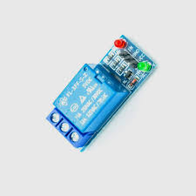
Relay
A relay is an electrically operated switch that allows a low-power control signal to switch a higher power load on or off. It consists of an electromagnet (coil), an armature, a spring, and one or more sets of contacts. When an electrical current passes through the coil, it generates a magnetic field that attracts the armature, causing the contacts to close or open and thereby controlling the flow of electricity to the load. Relays are commonly used in various applications, including automation systems, automotive circuits, and home appliances, to manage high-power devices with a low-power control signal. They provide isolation between the control circuit and the load, enhancing safety and reliability.

Slide 18
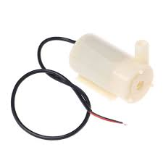
Dc pump
A DC pump motor is a type of electric motor designed to drive a pump using direct current (DC) power. It converts electrical energy into mechanical energy to move fluids or gases through a system. The motor typically includes a rotor and stator, with current flowing through the motor's windings generating a magnetic field that causes the rotor to spin. This rotational motion is then transferred to the pump, which creates the necessary pressure to move the fluid. DC pump motors are used in various applications, including water circulation in aquariums, irrigation systems, and cooling systems. They are appreciated for their precise speed control, efficiency, and suitability for applications requiring variable flow rates or pressures.

Slide 19
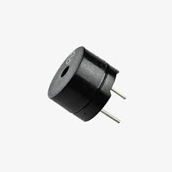
Buzzer
A buzzer is an electroacoustic device that produces sound when an electrical current passes through it. It typically consists of a coil of wire that surrounds a magnet and a diaphragm or other sound-producing mechanism. When powered, the alternating current causes the coil to move the diaphragm rapidly back and forth, generating sound waves. Buzzer sound can vary in tone and intensity depending on the design and frequency of the electrical signal applied to it. Buzzer is commonly used in various applications including alarms, notifications, signaling devices, and in electronic circuits for auditory feedback. It is simple in design, reliable, and widely used due to its effectiveness in alerting users to specific events or conditions.

Slide 20
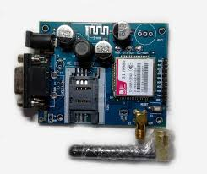
Gsm
GSM (Global System for Mobile Communications) is a widely adopted standard for mobile phone networks that facilitates voice calls, text messaging, and basic data services. Developed in the 1980s, GSM uses a SIM (Subscriber Identity Module) card for user identification and operates on various frequency bands such as 900 MHz, 1800 MHz, and 1900 MHz, depending on the region. The technology supports voice communication, SMS (Short Message Service), and limited data transmission through services like GPRS (General Packet Radio Service). GSM’s global reach ensures extensive coverage and connectivity across different countries and networks. It is known for its reliability, cost-effectiveness, and broad availability..

Slide 21
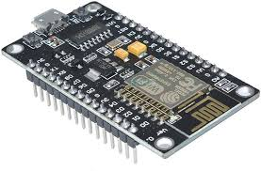
Nodemcu
NodeMCU is an open-source firmware and development kit based on the ESP8266 Wi-Fi module. It integrates a microcontroller unit (MCU), allowing it to be programmed using the Lua scripting language or through Arduino IDE with libraries tailored for the ESP8266. NodeMCU facilitates easy prototyping and development of IoT (Internet of Things) projects by providing built-in Wi-Fi connectivity, GPIO pins for interfacing with sensors and actuators, and USB-to-serial communication. It is popular among hobbyists and professionals alike for creating connected devices, home automation systems, and remote monitoring applications

Slide 22
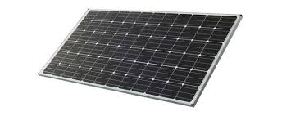
Solar panel(9v)
A solar panel, also known as a photovoltaic (PV) panel, is a device that converts sunlight directly into electricity through the photovoltaic effect. Composed of multiple solar cells made from semiconductor materials such as silicon, solar panels capture photons from sunlight, generating a flow of electrons that creates an electric current. This renewable energy source is highly valued for its environmental benefits, as it produces electricity without emitting greenhouse gases or other pollutants. Solar panels are widely used in various applications, from residential rooftop installations to large-scale solar farms, providing a sustainable and cost-effective alternative to fossil fuels

Slide 23
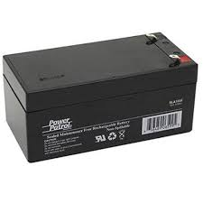
Battery
A 12V battery is a widely used power source in various electronic and electrical applications, providing a nominal voltage of 12 volts. It consists of multiple cells connected in series to achieve the desired voltage output. 12V batteries are commonly found in automotive systems, where they power the vehicle’s electrical components like lights, radio, and ignition systems. They are also used in renewable energy systems, such as solar power setups, to store energy for later use. These batteries come in several types, including lead-acid, lithium-ion, and gel cells, each offering different advantages in terms of capacity, lifespan, and maintenance requirements. Lead-acid batteries are known for their reliability and cost-effectiveness, making them a popular choice for automotive and backup power applications.

Slide 24
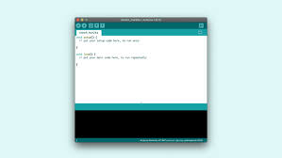
Arduino ide
The Arduino IDE (Integrated Development Environment) is a versatile software platform designed for programming Arduino microcontrollers. It offers a user-friendly interface that simplifies the process of writing, editing, and uploading code to various Arduino boards. The IDE supports programming in C and C++, providing a straightforward text editor with syntax highlighting, a compiler for converting code into machine language, and a serial monitor for real-time debugging and communication with the Arduino board. It also includes a library manager for accessing pre-written code libraries and a board manager for selecting and configuring different Arduino models. The Arduino IDE's open-source nature and extensive community support make it an essential tool for both beginners and advanced users, enabling the development of a wide range of electronic and embedded projects.

Slide 25

Python
Python is a high-level, interpreted programming language known for its simplicity and readability. It emphasizes code clarity and allows developers to express concepts in fewer lines of code compared to many other languages. Python supports multiple programming paradigms, including procedural, object-oriented, and functional programming. Its extensive standard library and a large ecosystem of third-party packages make it highly versatile, suitable for web development, data analysis, artificial intelligence, scientific computing, and more. Python’s straightforward syntax and robust community support have made it one of the most popular and widely used languages in the software industry.

Slide 26
Advantages
Automation
Efficiency
Sustainability
Remote-monitoring
Real-time

Slide 27
Applications
Agriculture
Horticulture
Landscaping
Greenhouses
Farming

Slide 28
Conclusion
The automatic irrigation system effectively integrates soil moisture and water level sensors with real-time monitoring through the Node MCU and Adafruit IoT platform. By incorporating GSM alerts, a buzzer for abnormal conditions, and an LCD for local display, the system ensures timely and efficient water management. The use of solar power enhances sustainability, while the DC pump automates irrigation based on sensor feedback, promoting optimal crop growth and resource conservation. Overall, this smart system offers a reliable, energy-efficient, and remote-controlled solution for modern agricultural needs.

Slide 29
References
[1] A. Klute, Methods of Soil Analysis, Part 1: Physical and Mineralogical Methods, Madison, WI, USA: American Society of Agronomy, 1986, pp. 1–1188.
[2] J. H. Knight, “Sensitivity of time domain reflectometry measurements to lateral variations in soil water content,” Water Resources Research, vol. 28, pp. 2345–2352, 1992.
[3] R. D. Magagi and Y. H. Kerr, “Retrieval of soil moisture and vegetation characteristics by use of ERS-1 wind scatterometer over arid and semi-arid areas,” J. Hydrology, vol. 188–189, pp. 361–384, 1997.
[4] H. P. Marthaler, W. Vogelsanger, F. Richard, and J. P. Wierenga, “A pressure transducer for field tensiometers,” Soil Sci. Soc. Am. J., vol. 47, pp. 624–627, 1983.
[5] E. Attema et al., “Sentinel-1 - the radar mission for GMES operational land and sea services,” ESA Bulletin, vol. 131, pp. 10–17, 2007.

